Slide 1
Malicious Applications

Slide 2
Malware
Insider Attacks
Backdoors/trapdoors
Logic Bombs
Virus
Polymorphic and Metamorphic Virus
Trojan Horses
Privacy-Invasive Software
Adware/Spyware
Worm
Botnet

Slide 3

Backdoor/Trapdoor
Secret entry point into a system
Specific user identifier or password that circumvents normal security procedures
Commonly used by developers
Could be included in a compiler

Slide 4
Logic Bomb
A logic bomb is a class of malicious code that is activated when a specific condition occurs.
Certain file is created
Certain time is reached
Certain user logins into the system
……
A logic bomb could represent
an “insider” threat
inherently malicious code

Slide 5
Virus
Self-replicating code
Malicious functions + self-replicating (with users’ involvement)
“Normal Code” => “Normal Code + Malicious Code”
Stealthy
Attempts to evade detection
Operates when infected code executed
Propagates
Performs malicious actions
Redirect to the normal code
Notes:
Alters normal code with “infected” version

Slide 6
Virus Infection Vectors
Boot Sector
Loaded when the system is booted
Executable
Activated when an executable file is activated
Macro files
Triggered when a document is loaded

Slide 7
Virus Characteristics
Terminate and Stay Resident
Stays active in memory after application completes
Allow infection of previously unknown files
Traps calls that execute a program
Stealthy
Conceal Infection
Trap read and disinfect
Let executable call infected file
Polymorphic/Metamorphic Virus
Change virus code to circumvent misuse detection

Slide 8
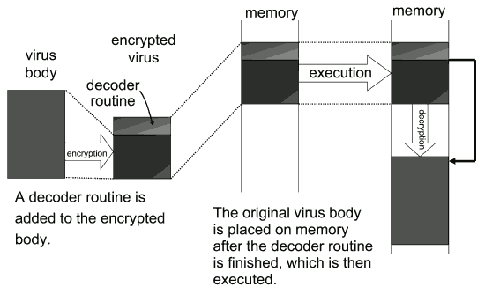
Polymorphic/Metamorphic Virus

Slide 9
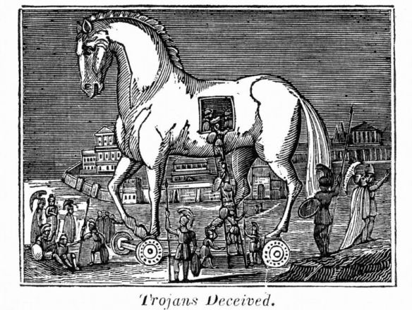
Trojan Horse
A Trojan Horse is a malicious program that is disguised as legitimate software
The gift horse left outside the gate of Troy by the Greeks
Appear to be interesting and innocent
Actually harmful

Slide 10
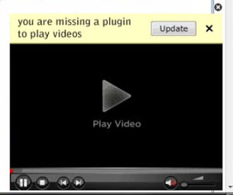
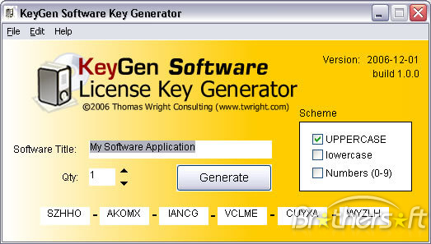
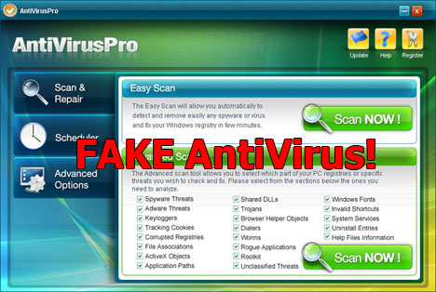
Trojan Horse
A Trojan Horse is a malicious program that is disguised as legitimate software
The gift horse left outside the gate of Troy by the Greeks
Appear to be interesting and innocent
Actually harmful

Slide 11
Privacy-Invasive Software
Malware with specific malicious objectives
Adware
Pop up advertisements
Spyware
Key logging, screen capturing

Slide 12
Worms
Definition: Programs that self-propagate across the internet by exploiting security flaws in widely used services

Slide 13
Virus v.s. Worms
Virus
A malicious program
Propagates depending on the user intervention
File sharing
Execute an infected file
Worm
A malicious program
Propagates automatously
Self-replicate
No user intervention is required

Slide 14
An Abstract Worm Model
Infected Host
Acquiring Targets (e.g., scanning)
Compromise
(e.g., exploits)
Deliver worm binary
Notes:
Here Probably I need to describe the scanning attacks.

Slide 15
Examples
Scanning
Does this host provide such service?
E.g., HTTP service (TCP, Port 80)
SrcIP: IP1, SrcPort: Port1
DstIP: IP2, DstPort: 80
TCP, SYN
Worm (IP1, Port1)
Host (IP2)
Worm
TCP, SYNACK

Slide 16
Examples
Exploiting
Get access to the remote host
E.g., buffer overflow attack
SrcIP: IP1, SrcPort: Port1
DstIP: IP2, DstPort: 80
TCP, SYN
Worm (IP1, Port1)
Host (IP2)
Worm
TCP, SYNACK
Shellcode (e.g., download and execute an executable from IP1, Port-X)

Slide 17
Examples
Deliver Worm Executable
Obtain and execute the worm executable
Worm (IP1, Port1)
Host (IP2)
Worm
Worm

Slide 18
A Brief History of Worms
Worms that affect the operation of the whole Internet
Morris Worm (1988)
Code Red (2001)
Nimda (2001)
Blaster (2003)
SQL Slammer (2003)

Slide 19

Morris Worm
A program of only 99 lines
6000 computers in just few hours
Disrupted the Internet at that time
Was not really “malicious” (only propagate, no damage to the data)
Exploits
BOF in Fingerd
Vulnerability in sendmail, which allows the execution of arbitrary commands
Brute force attacks to login (432 frequently used passwords)

Slide 20
Morris Worm
The positive impacts
Computer Emergency Response Team (CERT)
Reacted to the damage and disruption caused by Morris worm
Becomes a leading center on information sharing with respect to software vulnerability and malware
Raise attentions to cyber-security

Slide 21
The Code Red Worm
Rapid propagation
> 2,000 hosts/min
Code Red II Took about 14 hours to fully propagate
359,000 hosts are infected
Exploits
BOF in Microsoft IIS web server (enabled by default)

Slide 22
The Nimda Worm
Rapid Propagation
Became the Internet’s most widespread worm within 22 minutes
Exploits
MS IIS vulnerability (CVE-2000-0884)
Email itself as attachment based on email addresses harvested from the infected machine
Copy itself across open network shares
Add exploit code to web pages on compromised servers in order to infect clients that browse the pages
Leverage the backdoors left behind by Code Red II.

Slide 23
Blaster Worm
Exploits
BOF in MS OS
The patch had been released one month earlier than the incident
“The original Blaster was created after a Chinese cracking collective called Xfocus reverse engineered the original Microsoft patch that allowed for execution of the attack” from wiki
Attack
Launched DDoS attacks against windowsupdate.com

Slide 24
SQL Slammer Worm
Rapid Propagation
Leverage UDP, which is connectionless
Infected 75,000, 90% within 10 minutes
Exploits
BOF in MS SQL server
Notes:
Resulted in
Outages in 13,000 BofA ATMs
Cancel of flights

Slide 25
5.2.6. SQL Slammer Worm
Exploited another buffer overflow
Took a single 376-byte UDP packet
UDP connectionless -> spread quickly
Infected 75,000, 90% w/in 10 mins.
Attacked Microsoft SQL Server DB App
Disabled server, scanned random IPs to infect
Impact
Excessive traffic due to the worm propagating caused outages in 13,000 BofA ATMs
Airlines were cancelled & delayed

Slide 26
Deterministic epidemic models — Simple epidemic model
susceptible
infectious
State transition:
N: population; S(t): susceptible hosts; I(t): infectious hosts
dI(t)/dt = β S(t) I(t)
S(t) + I(t) = N
I(t)
t
Code Red Worm Propagation Modeling and Analysis – Cliff Zou
Notes:
(( Simple epidemic model simulation parameter is : I_0=1; N=1e6; beta0 = 1.8/N))
The simplest model in epidemic area is called “simple epidemic model”. It only considers two states and only one state transition. Suppose for a fixed population system with N hosts, S(t) is the number of susceptible hosts; I(t) is the infectious hosts. Then the dynamic of the system is described by this differential equation. It can be derived from previous homogeneous assumption.
This is the dynamic curve of the number of infectious hosts I(t). X axis is the time t. In the beginning only several hosts are infected. In the end all hosts are infected. From the equation, we can see that I(t) and S(t) are symmetric. It means that the shape of this increasing part at beginning is identical to the shape of this slowing down part at the end.
The simple epidemic model is a simplified ideal case. It has some problems. The infection rate β is fixed. And more important is that it has no “removed” state.

Slide 27
Build “Better” Worms
“Better”
Faster: so fast that the deployed detectors do not have enough time to respond
Stealthier: so stealthy that the worms can circumvent the detectors
S. Staniford, V. Paxson, and N Weaver, “How to 0wn the Internet in Your Spare Time”, Usenix 2002.

Slide 28
The Roadmap
Timeline
Structure
Morris Worm (1988)
Code Red I (2001)
Code Red II (2001)
Nimda (2001)
“How to 0wn the Internet in Your Spare Time” (2002)
Blaster (2003)
SQL Slammer (2003)
Code Red I
Any Improvements?
Strategies to build better worms
Practice: Code Red II and Nimda
Theory: Warhol Worm
Analyzing Existing Worms
Theoretical Analysis

Slide 29

The Code Red I
On July 19, 2001 more than 359,000 computers were infected with the Code Red I Version 2 (CRv2) worm in less than 14 hours.
43% of all infected hosts were in the United States,
11% originated in Korea followed
5% in China
There is a bug in the initial version of Code Red I Version 1 (CRv1).

Slide 30
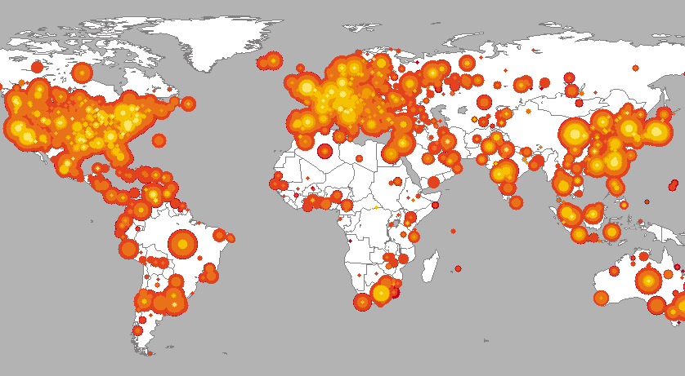
The Code Red I

Slide 31
The Code Red I
Its Scanning Strategy
Launch 99 threads and each thread generated random IP addresses in the whole IP space (2^32)
Probe each IP to determine whether the vulnerable service is available on the host.
If so, infect the host.

Slide 32
Build “Better” Worms - Practice
Code Red II
Nimda

Slide 33
Code Red II
Code Red II
CRII was released on August 4th, 2001.
Died by design on October 1th, 2001.
Localized Scanning Strategy
3/8 probability: a random IP from the B (/16 network) address space of the infected machine
½ probability: … from the A (/8 network) address….
1/8 probability: … from the whole Internet

Slide 34
Code Red II
Advantages of Localized Scanning
Facilitate propagation within certain internal networks
Firewall
NAT
Expedite propagation
Host with similar IP addresses imply a small network topological distance
Consequence
Rapid infection

Slide 35
Nimda
Nimda
Nimda began on September 18th, 2001.
It maintained itself on the Internet for months after it started
Multi-vector infection
Web server vulnerability (similar to the Code Red)
Bulk emailing of itself as an attachment
Copying itself across open network shares
Adding exploit code to Web pages on compromised servers in order to infect clients which browse the page
By using the backdoors left behind by Code Red II

Slide 36
Nimda
Enable propagation within internal networks (behind firewall or NATs)
Email
Network share
Exploit code in the compromised server
Magnify the effectiveness using multiple ways
Results
Became the Internet’s most widespread worm with in 22 minutes

Slide 37
Build “Better” Worms - Theory
Hit-list scanning
Permutation scanning
Topological aware worms
Internet scale hit-lists

Slide 38
Hit-list scanning
“…the time needed to infect say the first 10,000 hosts dominates the infection time.”
Hit-list scanning
Before the worm is released, the worm author collects a list of say 10,000 to 50,000 potentially vulnerable machines
The initial worm focuses on infecting hosts on the list
When it infects a machine, it divides the hit-list in half, communicating half to the recipient worm, keeping the other half

Slide 39
Hit-list scanning
How to collect hit-list in practice?
Stealthy scans
Distributed scanning
DNS searches
Spiders
33% of automated search engine queries are looking for vulnerable Internet services.
Public surveys
Just listen

Slide 40
Permutation Scanning
Random scanning
The Code Red I is a salient example to use random scanning
Disadvantage: many addresses are probed multiple times
Permutation Scanning
Objective: provide a self-coordinated, comprehensive scan while maintaining the benefits of random probing
Assumption: a worm can detect that a particular target is already infected

Slide 41
Permutation Scanning
All worms share a common pseudo random permutation of the IP address space
Any machine infected during the hit-list phase (or local subnet scanning) starts scanning after its point in the permutation
Whenever the worm sees an already infected machine, it chooses a new, random start point and proceeds from there
Worms infected by permutation scanning would start at a random point

Slide 42
Permutation Scanning
A Pseudo Random Permutation of the IP Address Space
0
Permutation
2^32 -1
0
2^32 -1

Slide 43
Permutation Scanning
A Pseudo Random Permutation of the IP Address Space
Worm 2
Worm 1
IP address space after permutation, common for all worms

Slide 44
Warhol Worm
Warhol = hit-list + Permutation
User simulation to demonstrate its effectiveness
Assumptions: complete connectivity within 2^32 IP address space
Parameters
The number of vulnerable machines
Scan per second
The time to infect a machine
Number infected during the hit-list phase

Slide 45
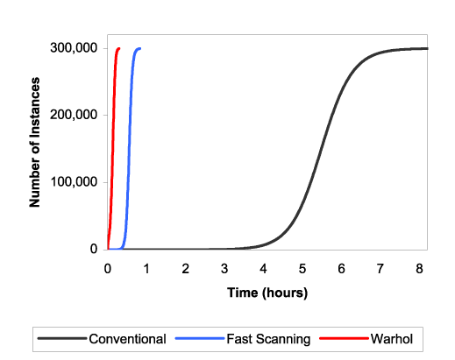
Warhol Worm
Simulation Results
Notes:
The spread of three simulated worms in a population of 300,000 vulnerable machines: (i) a Code Red-like worm capable of 10 scans/second, (ii) a faster scanning worm capable of 100 scans/second, and (iii) a Warhol worm, capable of 100 scans/second, using a 10,000 entry hit-list and permutation scanning which gives up when 2 infected machines are discovered without finding a new target. All graphs stop at 99.99% infection of the simulated address space.

Slide 46
Topological Scanning
Leverage information contained on the victim machine in order to select new targets
Very effective when the vulnerable targets exhibit a very sparse address space (compared to the whole address space)
Email worm
Perhaps IPv6? (You can investigate it!)
Examples:
Nimda
A worm attacking flaws of P2P applications
Use web URLs visited by the compromised machine

Slide 47
Flash Worm
Extend the hit-list worm
The hit-list contains a list of all or most Internet connected addresses with the relevant service(s) open
Capable of infecting the Internet in tens of seconds
Two challenges
A large hit-list (12.6 million web servers => 48 MB hit-list)
High-bandwidth link for attackers to identify all hosts providing the service(s)

Slide 48
Detection
Detect via honeypots
Any outbound connection from honeyfarm = worm.
Extract signature from inbound/outbound traffic.
Detect via failed connections
network elements that identify the hosts that make failed connection attempts to too many other hosts.
Detect via exploit content
BOF
Spam

Slide 49
Worm => Bot
Bot
Worm
Communication
Attacks
Attacks
Propagation
Propagation

Slide 50

Worm => Bot
Botmaster
Command and
control server
C&C channel
Attacks
Communication
Propagation
Attacks
Worm
Propagation
Bot
Autonomous
Controlled and Coordinated
Notes:
C&C channel is essential to a botnet. Without C&C, a botnet will be degraded into small groups of individual and isolated worms.

Slide 51
Worm => Bot
worm
bot
main(){
foreach(h in ScanList){
infect(h);
}
}
main(){
cnc = connect(C&C server);
while(every 5 minutes){
msg = cnc.read();
cmd = msg.cmd;
par = msg.parameter;
if(cmd.equal(“scan”)){
scanlist = par;
foreach(h in ScanList){
infect(h);
}
}
if(cmd.equal(“spam”)){
//send spam…..
}
}
}

Slide 52


Botnet
A botnet is a collection of bot-compromised hosts (bots) that are coordinated via a command and control (C&C) channel by an attacker to commit a variety of attacks
command
…
Theft
DDoS
Spam
botmaster
Infection
bots

Slide 53


Botnet
External Network
(e.g., another country)
Router
Router
Router
A large network (e.g., ISP or a country’s network)
Notes:
The law enforce department does not have access to every sub network such as enterprise network.

Slide 54

Botnet
External Network
(e.g., another country)
Botnet C&C Server
Router
Router
Router
A large network (e.g., ISP or a country’s network)
Notes:
The law enforce department does not have access to every sub network such as enterprise network.

Slide 55
Botnet
The infrastructure responsible for a variety of cyber attacks
Distributed Denial of Service
Spamming
Click fraud
Phishing
……

Slide 56
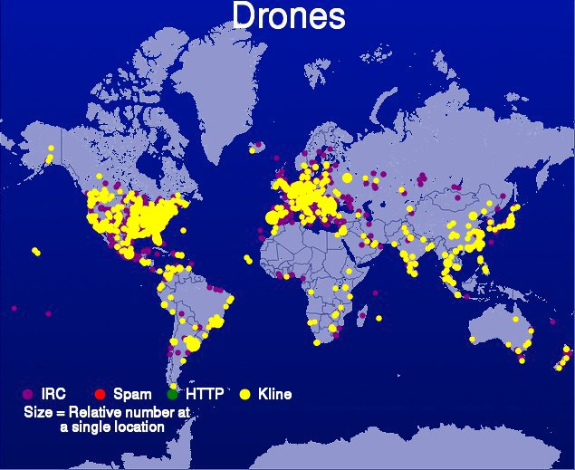

Botnet – A Global Problem

Slide 57
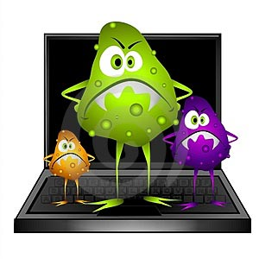

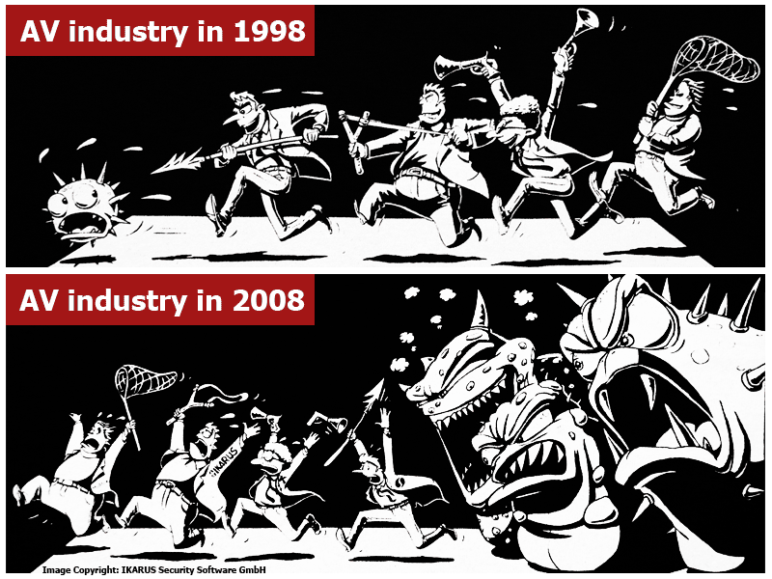
Botnet - A Persistent Threat

Slide 58
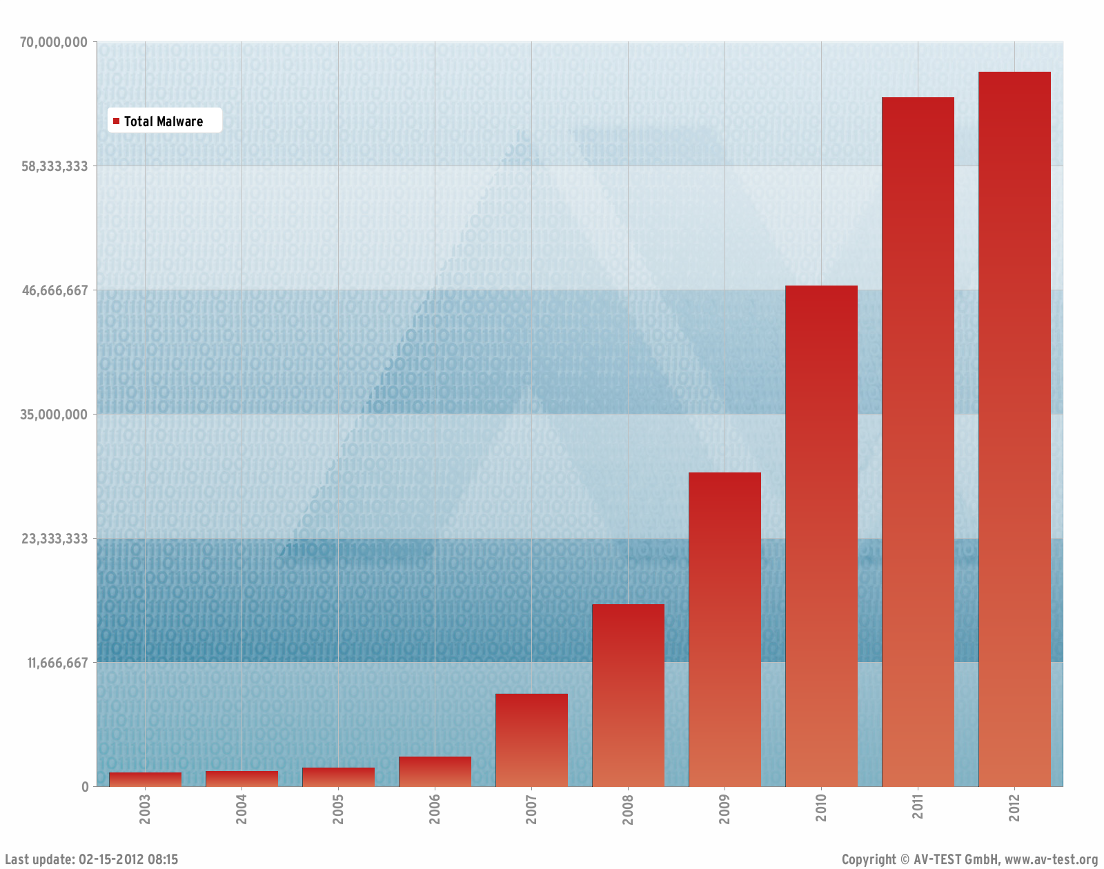
Botnet - A Persistent Threat

Slide 59


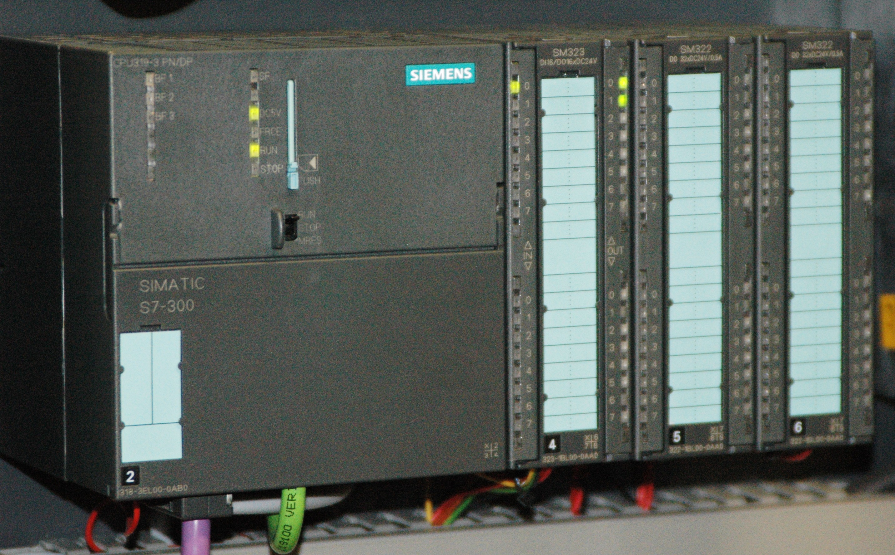
Botnet - A Persistent Threat
Supervisory control and data acquisition (SCADA) systems

Slide 60
Roadmap
Botnet C&Cs
How to detect botnets in network traffic?
How to build robust C&C against disruption?
Evolution of C&Cs
Botnet Detection

Slide 61
Botnet C&Cs
C&C channels are essential to botnets
Without C&C, a botnet will be degraded into individual bots
C&C

Slide 62
The War Field
Botmasters
Network Operators
Objective: keep most of their bots operational against disruption efforts
Resources: access public network resources such as registering domains, setup servers, and etc.
Objective: disrupt botnets at scale using affordable costs
Resources
Bot binary
Execute it for a short time (efficient)
Capability of reverse engineering (labor-intensive)
Access public network resources such as DNS
Limited financial resources

Slide 63

Build Robust C&Cs – Round 1
A Bot
Disruption Strategy
Directly connect to one C&C server or a small number of C&C servers based on IP(s) (i.e., botnet with Centralized C&Cs)
Block all connections to the IP address(es)
Network-level
Efficient
Take down the server if you are capable of doing it
You may not be able to do it if the server is out of your control (e.g., in foreign countries)
main(){
cnc = connect(“111.111.111.111”);
while(every 5 minutes){
msg = cnc.read();
……
}
}
C&C server

Slide 64
How does DNS work?
Root server
“.com” server IP?
Recursive
DNS server
cash.foo.com
Com server
“.foo.com” server IP?
cash.foo.com: X.X.X.X
“cash.foo.com” IP?
cash.foo.com: X.X.X.X
foo server

Slide 65
Build Robust C&Cs – Round 2
A Bot
Disruption Strategy
Use DNS to add more agility to the C&C server
E.g., give new IP every time when a bot issues the DNS query
Centralized C&C
IP + firewall may not work well
Execute the binary
Hijack the malicious domain in your network
Collaborate with DNS service to disrupt the DNS record
You may not be able to do it
Take down the C&C server(s) if you can
main(){
cnc = connect(“www.malicious.com”);
while(every 5 minutes){
msg = cnc.read();
……
}
}

Slide 66
Build Robust C&Cs – Round 3
A Bot
Disruption Strategy
User automatically generated DNS
E.g., automatically generate a new domain name every day;
Attacker randomly pick one domain for each day and register the domain
Reverse engineering the bot executable and discover those automatically generated domains
Proactively register all of them (N domain names)
Cost: N * R
R: the cost to register one domain
Notes:
If you do not have the capability to reverse engineering the bot binary, this approach is very effective.

Slide 67
Build Robust C&Cs – Round 4.1
Conficker D variant: 50,000 domains across 110 TLDs per day!
A Bot
Disruption Strategy
User automatically generated DNS
E.g., automatically generate a lot domain names every day;
Query all of them;
Use the IP that is successfully resolved;
Attacker randomly pick one domain for each day and register the domain
Reverse engineering the bot executable and discover those automatically generated domains
Proactively register all of them (N domain names)
Cost: N * R
R: the cost to register one domain

Slide 68
Build Robust C&Cs – Round 4.2
A Bot
Disruption Strategy
Eliminate the centralized C&Cs
Build a C&C with peer-to-peer structure
Identify bots and take them down. But the whole botnet is still functional unless a significantly large portion of peer-to-peer bots are taken down
command
Examples: Storm, Waledac, Conficker
botmaster
P2P Botnets

Slide 69



Detecting Centralized IRC-Based Botnet
Detection System
Internet
Mirroring Traffic
Network Traffic
Router
Monitored Network
G. Gu, J. Zhang, and W. Lee, “BotSniffer: Detecting Botnet Command and Control Channels in Network Traffic”, NDSS 2008

Slide 70
Detecting C&C Channels
C&C is essential to a botnet
Without C&C, a botnet will be degraded into individual infections, incapable of launching large-scale and coordinated attacks
Detecting C&C is important
Reveal both C&C servers and bots
An effective way to mitigate botnet threats

Slide 71
Bot Examples
IRC/HTTP-based C&C
botmaster
IRC server
botmaster
HTTP server
join
?
join
No
?
command
command
command
No
Execute
?
command
Execute
Response
Response
? + report
Nothing

Slide 72
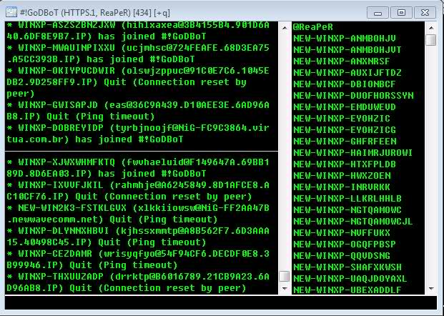
Bot Examples
IRC-based C&C
botmaster
IRC server
botmaster
HTTP server
join
?
join
No
?
command
command
command
No
Execute
?
command
Execute
Response
Response
? + report
Nothing

Slide 73
Bot Examples
HTTP-based C&C
botmaster
HTTP server
?
No
?
command
No
?
command
Execute
? + report
Nothing
Source: “The Anatomy of Clickbot.A”

Slide 74
Roadmap
Signature Match
IRC: NICK, PRIVMSG…
HTTP: GET, POST…
Network Traffic
IRC Traffic
HTTP Traffic
Others
?
?
IRC by bots
Others
HTTP by bots
Others

Slide 75
Intuition
C&C server
Establish the C&C connection;
while(cmd=receive(server))
{
If(cmd.match(“sys.info”))
{
mem = OS.getMemSize();
disk = OS.getDiskSize();
IP = OS.getIP();
send(“ IP: ” + IP + “ Mem: ” + mem + “ Disk” + disk);
}
If(cmd.match(“scan”))
{
n = Attack.scan();
send(“scan done ” + n + “ infected”);
}
}
Bot
Notes:
Message Response.

Slide 76
Intuition
C&C server
IP: 192.168.1.10,
Memory: 2G,
Disk: 200G.
Scan done 0 infected
# of apps: 200
username: xy
“sysinfo”
“Scan”
“status”
Spatial
Similarity
Scanning behavior
time
Bot1
Spatial-temporal
Similarity
IP: 192.168.1.23,
Memory: 1G,
Disk: 100G.
Scan done 2 infected
# of apps: 10
username: mn
Scanning behavior
time
Bot2

Slide 77
Intuition
IRC server
“hi”
hello
“I am Sam”
Nice to see you!
“Bye”
See u
time
IRC User1
hi
Go away!
great
time
IRC User2

Slide 78
Intuition
Detection algorithm in a nutshell
For an IRC server, if the majority of its clients in our monitored network keep responding similar responses to the server, we will label the clients as bots and the server as C&C server
How can we expand our intuition to a system?

Slide 79

Intuition
Detection algorithm in a nutshell
For an IRC server, if the majority of its clients in our monitored network keep responding similar responses to the server, we will label the clients as bots and the server as C&C server
Edit Distance: Use DICE coefficient to evaluate the similarity between two texts
E.g., “abcde” and “bcdef”, common 2-grams: “bc,cd,de”, DICE distance is 2*3/(4+4)=6/8=0.75
SPRT(Sequential Probability Ratio Testing): calculate an anomaly score by observing a sequence of certain actions (e.g., similar/dissimilar behaviors)

Slide 80
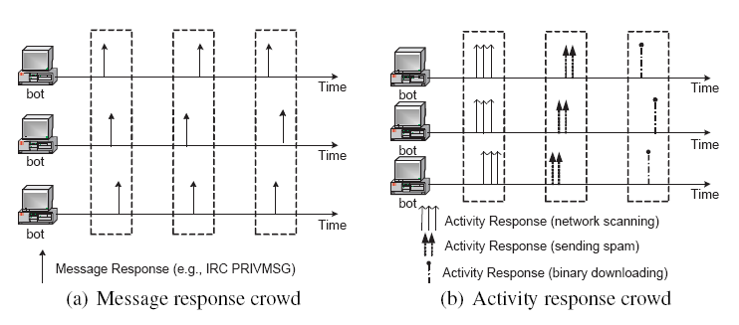
Detection

Slide 81
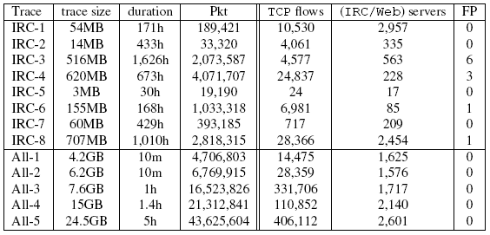
Experiments
189 days’ of IRC traffic

Slide 82
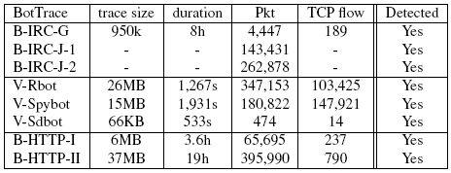
Experiments

Slide 83
Detecting P2P Botnets
P2P Botnet: A botnet with a peer-to-peer C&C structure
command
botmaster
P2P Botnets
Notes:
P2P botnet is a collection of bots which form a P2P overlay network for C&Cs, where bot each can serve as both a client and server. The botmaster can drop the command in any bot. Other bots can then seek the command and get it executed.
Compared to the the botnets with centralized architecture, P2P botnets do not suffer from single-point-of-failure. Even portion of the peers are taken down, the rest of them can still function well. And therefore, they serve as a much more robust infrastructure.
Several P2P botnets have emerged such as XXX, XXX, XXX, XXX. Since the P2P botnets do not have single point of failure, it would be extremely challenging to take them down. So it is of great demanding to detect bots in the monitored networks.

Slide 84
Goal
A network-based P2P-botnet detection system
P2P-botnet detector
Internet
Mirroring Traffic
Network Traffic
Router
Monitored Network

Slide 85


Challenges
Stealthy: malicious activities are hard to be observed
Global view of network topology is unavailable
Legitimate P2P applications run on bot-infected hosts
Scalability
Massive Spamming
Spamming
Comm
Hijack accounts
Correlation
Attacks
Monitored Networks
Monitored Networks
P2P bot detection
ICDCS 2010
BotMiner: Usenix
Security 2008
BotGrep:
Security 2010
Notes:
However, it is very challenging to detect P2P botnets which can work in practice.
First, stealthy. …. The existing approach, such as botminer, which depend on malicious activity information, fail.
Second, as a practical solution, the detection method may only has the visibility of the local enterprise networks or the ISP networks, instead of a global overview of the Internet topology. So any approach, which depends on a global overview of the Internet topology, may not work in practice.
Third, due to the popularity of P2P software, a bot-compromised host may also run legitimate P2P software such as the filing sharing software. In this case, any effort to distinguish the bot-compromised host from legitimate P2P applications may fail to work, such as a P2P botnet detection approach proposed in ICDCS.
So we need a new P2P botnet detection system, the system should be:
Does not rely on attack informaiton, only rely on C&C information, which is the essential part of a botnet.
Does not need global overview, which can be practically deployed in enterprise networks and ISP networks.
Is capable of detecting P2P bots even if the bot-compromised hosts are running legitimate P2P applications.
Only relies on C&Cs to detect botnets
Does not require network topology info
Detects P2P bots even they are running legitimate P2P applications

Slide 86
System Architecture
Bots
P2P bots
P2P-Bot Detection
www.google.com
74.125.115.103
74.125.115.106
74.125.115.105
Legitimate P2P Clients + P2P bots
P2P-Client Detection
DNS
NetworkFlows
Monitored Networks
Internet
Network Traffic
Notes:
For flows, say it does not rely on packet payload information.
Each step will help us closer to the P2P bots

Slide 87
P2P Client Detection
Bots
Host1
Host2
Host3
P2P-Bot Detection
P2P-Client Detection
Which hosts are P2P Clients?
Host_M
Host_N
DNS
NetworkFlows
Network Traffic
Notes:
For flows, say it does not rely on packet payload information.
Each step will help us closer to the P2P bots

Slide 88
Why Not Using Existing P2P Detection Methods?
Existing P2P traffic detection Methods
Content signatures
Transport layer heuristics (e.g., port number, protocols)
Learning-based methods
Practical Challenges
Traffic is encrypted (Skype, Storm)
Obfuscated protocols
Port number is dynamically calculated
Protocol tunnel
Training data is unavailable
Notes:
However, it is very challenging to detect P2P botnets which can work in practice.
First, stealthy. …. The existing approach, such as botminer, which depend on malicious activity information, fail.
Second, as a practical solution, the detection method may only has the visibility of the local enterprise networks or the ISP networks, instead of a global overview of the Internet topology. So any approach, which depends on a global overview of the Internet topology, may not work in practice.
Third, due to the popularity of P2P software, a bot-compromised host may also run legitimate P2P software such as the filing sharing software. In this case, any effort to distinguish the bot-compromised host from legitimate P2P applications may fail to work, such as a P2P botnet detection approach proposed in ICDCS.
So we need a new P2P botnet detection system, the system should be:
Does not rely on attack informaiton, only rely on C&C information, which is the essential part of a botnet.
Does not need global overview, which can be practically deployed in enterprise networks and ISP networks.
Is capable of detecting P2P bots even if the bot-compromised hosts are running legitimate P2P applications.
Only relies on C&Cs to detect botnets
Does not require network topology info
Detects P2P bots even they are running legitimate P2P applications

Slide 89
P2P Client Detection
Peer-B
Internet
Monitored
Networks
Peer-A
P2P Control Messages
Used to maintain the functionality of P2P networks
Essential to any P2P network
Examples: PING/PONG, Routing Update, Content Publish
A P2P Control Flow: A network flow corresponding to a network session of control messages
Notes:
Although coarse-grained is good, it is not enough. For example, a mis-configured application may initiate a large number of failed connections.
So in order to further accurately identify P2P clients, we leverage the control flows of P2P applications for fine-grained analysis.
A control flow is a network flow that carries the control message for P2P application. The control messages are those protocol messages used to maintain the functionality of the P2P network. For example, PING/PONG message is used to verify the availability of the peers. Routing update messages are used to keep the routing table fresh.
The control flows are essential for P2P applications, since they are used to guarantee proper functionality of the whole P2P overlay networks. P2P Control flows have 4 characteristics that may help us on detection:
1.
2.
3. Control flows of different applications have different flow sizes since they have different implementations.

Slide 90
An Example of A P2P Control Flow
PING/PONG
while(every 3 miniutes)
{
foreach(p in PeerList)
{
var s = new Connection(p);
s.send(“PING” + self.time() + self.id());
var data = s.receive();
s.close();
//process data
}
}
Peer-A
[t1, Peer-A, Peer-B, UDP, 1, 1, 100, 200]
Is this client a P2P client?
=
Does this client generate P2P control flows?
Notes:
Here we give one example of a P2P control flow.
We start from a typical program used to generate control messages. We take PING/PONG message for example. Other control messages, such as routing update, will have similar program.
This function is periodically triggered. And once it is triggered, it will enumerate each peer in the peerlist, and then initiate a network session to this peer in order to exchange control message. As we have discussed, this piece of code is corresponding to a network session and we can observe a network flow in the network traffic. And we call this flow as P2P control flow because it is corresponding to a P2P control message.
After we introduce the concept of P2P control flow. The question, is this client a P2P client, can be translated to another question, does this client generate any P2P control flows.

Slide 91
Characteristics of P2P Control Flows
PING/PONG
while(every 3 miniutes)
{
foreach(p in PeerList)
{
var s = new Connection(p);
s.send(“PING” + self.time() + self.id());
var data = s.receive();
s.close();
//process data
}
}
time
Automatically generated
……
……
......
Notes:
Although coarse-grained is good, it is not enough. For example, a mis-configured application may initiate a large number of failed connections.
So in order to further accurately identify P2P clients, we leverage the control flows of P2P applications for fine-grained analysis.
A control flow is a network flow that carries the control message for P2P application. The control messages are those protocol messages used to maintain the functionality of the P2P network. For example, PING/PONG message is used to verify the availability of the peers. Routing update messages are used to keep the routing table fresh.
The control flows are essential for P2P applications, since they are used to guarantee proper functionality of the whole P2P overlay networks. P2P Control flows have 4 characteristics that may help us on detection:
1.
2.
3. Control flows of different applications have different flow sizes since they have different implementations.

Slide 92

Characteristics of P2P Control Flows
PING/PONG
while(every 3 miniutes)
{
foreach(p in PeerList)
{
var s = new Connection(p);
s.send(“PING” + self.time() + self.id());
var data = s.receive();
s.close();
//process data
}
}
Gmail Server
IP: 74.125.224.56
DNS server
Peer-B: 22.22.22.22
74.125.224.56
1
3
2
mail.google.com
Peer-A
Browsers/Email-Clients/IMs
For traffic reduction!
Automatically generated
DNS-Free, different from popular network applications
......
……
Notes:
Although coarse-grained is good, it is not enough. For example, a mis-configured application may initiate a large number of failed connections.
So in order to further accurately identify P2P clients, we leverage the control flows of P2P applications for fine-grained analysis.
A control flow is a network flow that carries the control message for P2P application. The control messages are those protocol messages used to maintain the functionality of the P2P network. For example, PING/PONG message is used to verify the availability of the peers. Routing update messages are used to keep the routing table fresh.
The control flows are essential for P2P applications, since they are used to guarantee proper functionality of the whole P2P overlay networks. P2P Control flows have 4 characteristics that may help us on detection:
1.
2.
3. Control flows of different applications have different flow sizes since they have different implementations.

Slide 93
Characteristics of P2P Control Flows
PING/PONG
while(every 3 miniutes)
{
foreach(p in PeerList)
{
var s = new Connection(p);
s.send(“PING” + self.time() + self.id());
var data = s.receive();
s.close();
//process data
}
}
Comcast
AT&T
P2P Client
202.117.1.7
Peer-C
117.1.1.2
Comcast
AT&T
Chinacom
Eurocom
……
202.117.1.2
Peer-D
Peer-B
Peer-E
Chinacom
126.2.3.1
Internet
Monitored
Networks
Peer-A
Automatically generated
DNS-Free, different from popular network applications
Sent to a large number of organizations (represented by network prefixes)
……
Notes:
Although coarse-grained is good, it is not enough. For example, a mis-configured application may initiate a large number of failed connections.
So in order to further accurately identify P2P clients, we leverage the control flows of P2P applications for fine-grained analysis.
A control flow is a network flow that carries the control message for P2P application. The control messages are those protocol messages used to maintain the functionality of the P2P network. For example, PING/PONG message is used to verify the availability of the peers. Routing update messages are used to keep the routing table fresh.
The control flows are essential for P2P applications, since they are used to guarantee proper functionality of the whole P2P overlay networks. P2P Control flows have 4 characteristics that may help us on detection:
1.
2.
3. Control flows of different applications have different flow sizes since they have different implementations.

Slide 94

Characteristics of P2P Control Flows
PING/PONG
while(every 3 miniutes)
{
foreach(p in PeerList)
{
var s = new Connection(p);
s.send(“PING” + self.time() + self.id());
var data = s.receive();
s.close();
//process data
}
}
PING/PONG
[1, 1, 100, 200]
Routing Update
[1, 1, 300, 400]
[1, 1, 310, 400]
Routing Update
s.send(p, “Routing ” + self.RoutingTable());
Automatically generated
DNS-Free, different from popular network applications
Sent to a large number of organizations
P2P control flows used for the same purpose will share similar flow size regarding the same P2P application
Notes:
Fourth, the control messages are highly formatted and the control messages of the same type usually variance on the length. Since the length of the message implies the size of the flow, regarding the number of packets and bytes exchanged, the control flows for the same type of control messages will share similar flow size.
Control flows of different types follow different implementations, and therefore, they will have different flow sizes.
So we come up with the fourth characteristic: for the same type of P2P application, P2P control flows of the same type lf control messages share similar flow size.

Slide 95
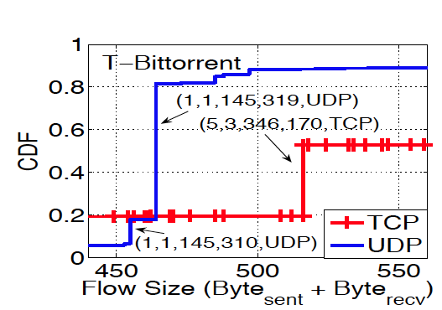
Characteristics of P2P Control Flows
Routing update
Index update
PING/PONG
P2P Control flows for the same purpose (e.g., PING/PONG) share similar flow size
P2P Control flows for different purposes (e.g., PING/PONG vs. Routing Update) have different flow sizes
Notes:
Although coarse-grained is good, it is not enough. For example, a mis-configured application may initiate a large number of failed connections.
So in order to further accurately identify P2P clients, we leverage the control flows of P2P applications for fine-grained analysis.
A control flow is a network flow that carries the control message for P2P application. The control messages are those protocol messages used to maintain the functionality of the P2P network. For example, PING/PONG message is used to verify the availability of the peers. Routing update messages are used to keep the routing table fresh.
The control flows are essential for P2P applications, since they are used to guarantee proper functionality of the whole P2P overlay networks. P2P Control flows have 4 characteristics that may help us on detection:
1.
2.
3. Control flows of different applications have different flow sizes since they have different implementations.

Slide 96
P2P Client Detection
Bots
P2P-Bot Detection
P2P-Client Detection
Clustering-Based Flow Analysis
DNS-Based Traffic Filtering
DNS
NetworkFlows
Network Traffic
Notes:
For flows, say it does not rely on packet payload information.
Each step will help us closer to the P2P bots

Slide 97

DNS-Based Traffic Filtering
Characteristic: Control flows are DNS-free
Discard flows whose destination IPs are resolved from DNS queries
Client
www.google.com
74.125.224.55
74.125.224.56
IP: 74.125.224.56
time
Notes:
Although coarse-grained is good, it is not enough. For example, a mis-configured application may initiate a large number of failed connections.
So in order to further accurately identify P2P clients, we leverage the control flows of P2P applications for fine-grained analysis.
A control flow is a network flow that carries the control message for P2P application. The control messages are those protocol messages used to maintain the functionality of the P2P network. For example, PING/PONG message is used to verify the availability of the peers. Routing update messages are used to keep the routing table fresh.
The control flows are essential for P2P applications, since they are used to guarantee proper functionality of the whole P2P overlay networks. P2P Control flows have 4 characteristics that may help us on detection:
1.
2.
3. Control flows of different applications have different flow sizes since they have different implementations.

Slide 98
Clustering-Based Flow Analysis
# of organizations
in a cluster > θ ?
Host1
YES
Host1 (P2P Client)
Fingerprint
Clusters
Characteristic: Control flows for the same purpose share similar size
Clustering
YES
Characteristic: Control flows are sent to a large number of organizations
NO
Scalable Clustering Analysis
Two-level clustering scheme: Streaming Clustering (Birch) + Hierarchical Clustering
Distribute the clustering analysis workload
NO
time
Aggregate flows with similar size into one cluster
Define a cluster as a fingerprint cluster if # of unique organizations >= θ (=50)
Claim a host as a P2P client if it has at least one fingerprint cluster
Notes:
Although coarse-grained is good, it is not enough. For example, a mis-configured application may initiate a large number of failed connections.
So in order to further accurately identify P2P clients, we leverage the control flows of P2P applications for fine-grained analysis.
A control flow is a network flow that carries the control message for P2P application. The control messages are those protocol messages used to maintain the functionality of the P2P network. For example, PING/PONG message is used to verify the availability of the peers. Routing update messages are used to keep the routing table fresh.
The control flows are essential for P2P applications, since they are used to guarantee proper functionality of the whole P2P overlay networks. P2P Control flows have 4 characteristics that may help us on detection:
1.
2.
3. Control flows of different applications have different flow sizes since they have different implementations.

Slide 99
P2P-Botnet Detection
Bots
P2P-Client1
P2P-Client2
P2P-Bot Detection
P2P-Client Detection
P2P-Client_M
P2P-Client_N
DNS
NetworkFlows
Which P2P-Clients are P2P-Bots?
Network Traffic
Notes:
For flows, say it does not rely on packet payload information.
Each step will help us closer to the P2P bots

Slide 100
P2P Bots v.s. Legitimate P2P Clients
 | P2P Bots | Legitimate P2P Clients
Temporal Feature | Persistent | Transient
Spatial Feature | Same content (commands) => Large overlap of peers | Different contents => Small overlap of peers
“Cmd”
“Cmd”
“avatar”
“mp3”
P2P Bots
Legitimate P2P Clients

Slide 101
Temporal Feature Based Detection
A P2P client is persistent if
T(P2P) / T(Host) > 0.5
Characteristic: Control flows are automatically generated
Dur(FC₁)
Dur(FC₂)
T(P2P)
T(Host)
Fingerprint Clusters
time
T(P2P) ≅ MAX(Dur(FC₁), Dur(FC₂)……Dur(FC_{n}))

Slide 102
Spatial Feature Based Detection
H_{m} | H_{k} | Dist_{H}(H_{m} , H_{k})
Bot1 | Bot2 | Small
Bot1 | Bot2 + Emule1 | Small
Emule1 | Emule2 | Large
Bot1 | Emule1 | Large

Slide 103
Spatial Feature Based Detection
A pair of persistent P2P clients belong to a botnet if they have a small Dist_{H}(), using hierarchical clustering algorithm
botnet1
botnet2
Dist_{H}(): small
Dist_{H}(): Large

Slide 104
Evaluation
Data
Data | # of hosts and clients | Summary
College networks | 1K hosts 3 Bittorrent clients 5 Skype clients | 24 hours 1K hosts totally 18 legitimate P2P apps 16 Real P2P bots 80 Million flows
Legitimate P2P applications | 2 Bittorrent clients 2 Emule clients 2 Ares clients 2 Skype clients 2 Limewire clients
P2P botnets | 13 Storm bots 3 Waledac bots

Slide 105
Evaluation
Bots
5 hours on a single server;
0.69 hour on 10 servers.
P2P-Bot Detection
Spatial Feature
66% reduction of hosts.
Preserve ≥97% P2P flows
Temporal Feature
All P2P Clients Detected
100% Detection Rate;
0.2% False Alarm Rate
P2P-Client Detection
Clustering-Based Analysis
Traffic Filtering
DNS
Flows
Network Traffic

Slide 106
Conclusion of P2P Botnet Detection
A novel method to detect and profile P2P applications
A novel DNS-based traffic filter
A Clustering-based flow analysis approach
A novel P2P botnet detection method
Detect bots even if their underlying operating systems are running legitimate P2P applications
Detect bots even if their malicious activities are not observed
100% detection rate
0.2% false alarm rate
A scalable system
Process 80 million flows in 0.69 hours
Notes:
Add some numbers here.

Slide 107
Limitations and Future Work
Evasion
Randomize the communication
Randomize the command
Backbone network
Network flows are heavily sampled
Online Detection

